Slide 1
Kinetic-scale solar wind current sheets
Statistical characteristics and their role in energetic particle transport

Slide 2
Table of contents
Part 0: Research Context and Background
Part 1: Observational Analysis of Current Sheets
Part 2: Quantitative Modeling of Particle Scattering
Part 1.5: Multifluid Model for Current Sheet Alfvénicity
Part 0: Software Development
Part 3: Proposed Research
Conclusion
References

Slide 3
Graduate Student: Zijin Zhang
Supervisor: Vassilis Angelopoulos
Committee: Marco Velli, Hao Cao, Paulo Alves, Anton Artemyev
“ The dinosaurs became extinct because they didn’t have a space programme. ” - Larry Niven

Slide 4
Part 0: Research Context and Background

Slide 5
“ You don’t have to know everything. You simply need to know where to find it when necessary. ” - John Brunner
Understanding how energetic particles are transported in the heliosphere (and accelerated) remains one of the central problems in space physics & astrophysics. Despite decades of research, many long-standing questions persist.
solar energetic particles (SEPs)
cosmic ray (CRs)
Parker transport equation (TE) (Parker 1965):
$$\frac{∂f}{∂t}=\frac{∂}{∂x_{i}}\left[κ_{ij}\frac{∂f}{∂x_{j}}\right]−U_{i}\frac{∂f}{∂x_{i}}−V_{d,i}\frac{∂f}{∂x_{i}}+\frac{1}{3}\frac{∂U_{i}}{∂x_{i}}\left[\frac{∂f}{∂lnp}\right]+\text{Sources}−\text{Losses}, \left(1\right)$$
It captures four main transport processes:
spatial diffusion (particle scattering)
advection with the solar wind
drifts (such as gradient and curvature drifts)
adiabatic energy change
However, these frameworks struggle to explain all the dynamics observed.

Slide 6
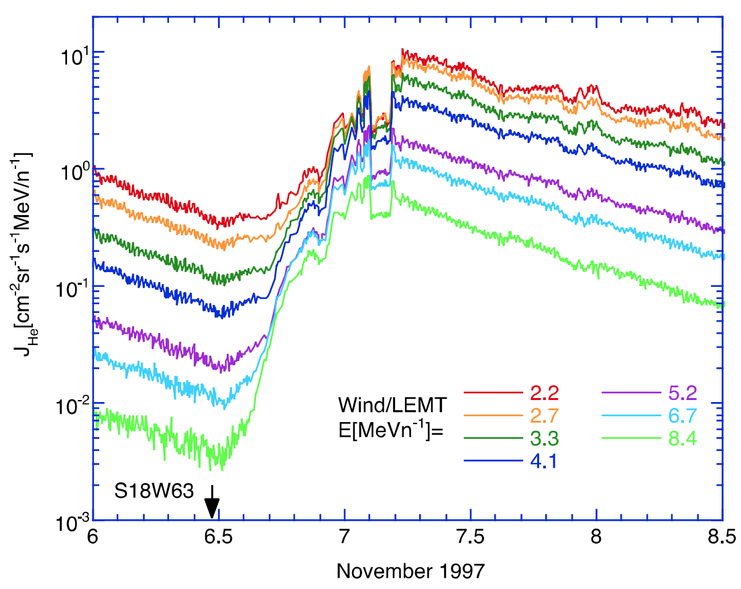
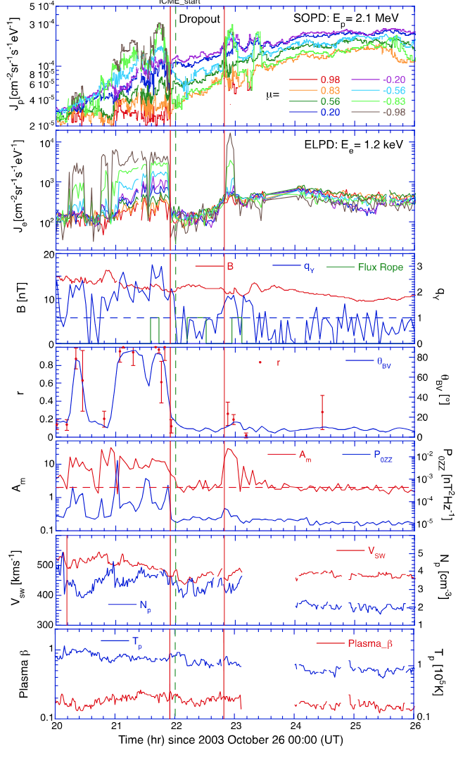
Dropouts
Time profiles of lowenergy He ion intensities recorded by the Wind/LEMT sensor showing a gradual SEP event beginning on 1997 November 6. A dropout in ion intensity lasting about 2 hr can be seen during the decay phase of the gradual event. (Tan 2023)
dropout period having $θ_{BV}∼0°$

Slide 7
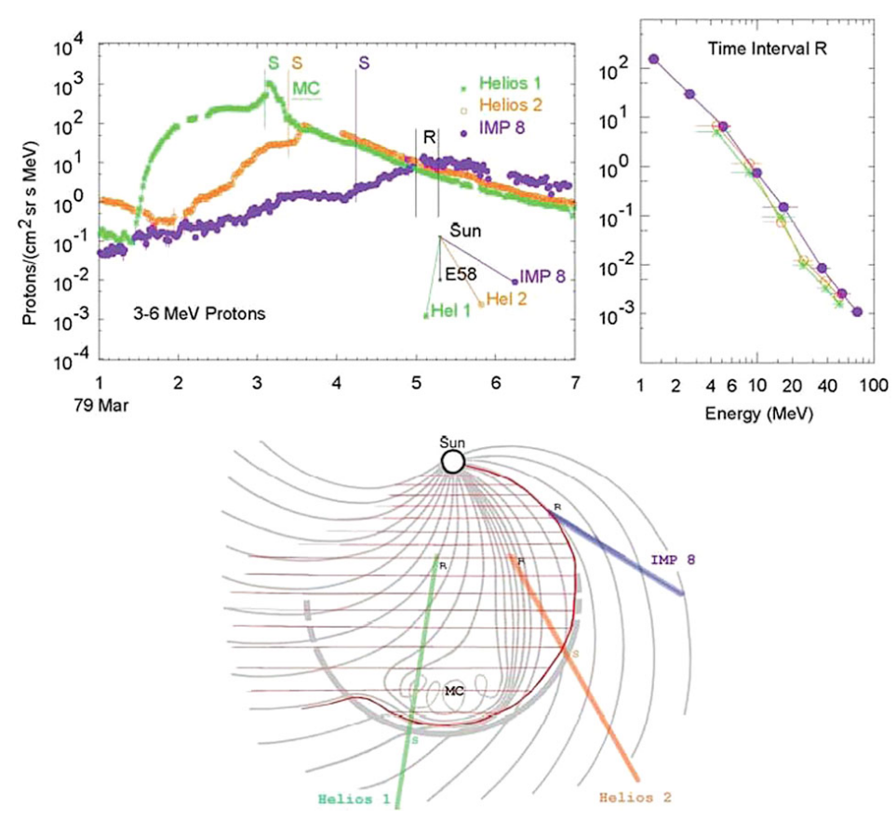
Reservoir
Effective cross-field and non-diffusive transport (Lario 2010)
A region where the intensities and energy spectra throughout much of the inner heliosphere (see Fig. 52: top right panel) at different azimuthal, radial, and latitudinal locations are nearly identical
Intensity-time profiles for protons in the 1979 March 1 event at 3 spacecraft are shown in the upper left panel with times of shock passage indicated by S for each. Energy spectra in the “reservoir” at time R are shown in the upper right panel while the paths of the spacecraft through a sketch of the CME are shown below (Reames 2013)

Slide 8
Anomalous transport and non-Markovian phenomena
$$\left\langle Δx^{2}\left(t\right)\right\rangle ∝t^{α}$$
Perri and Zimbardo (2007)

Slide 9
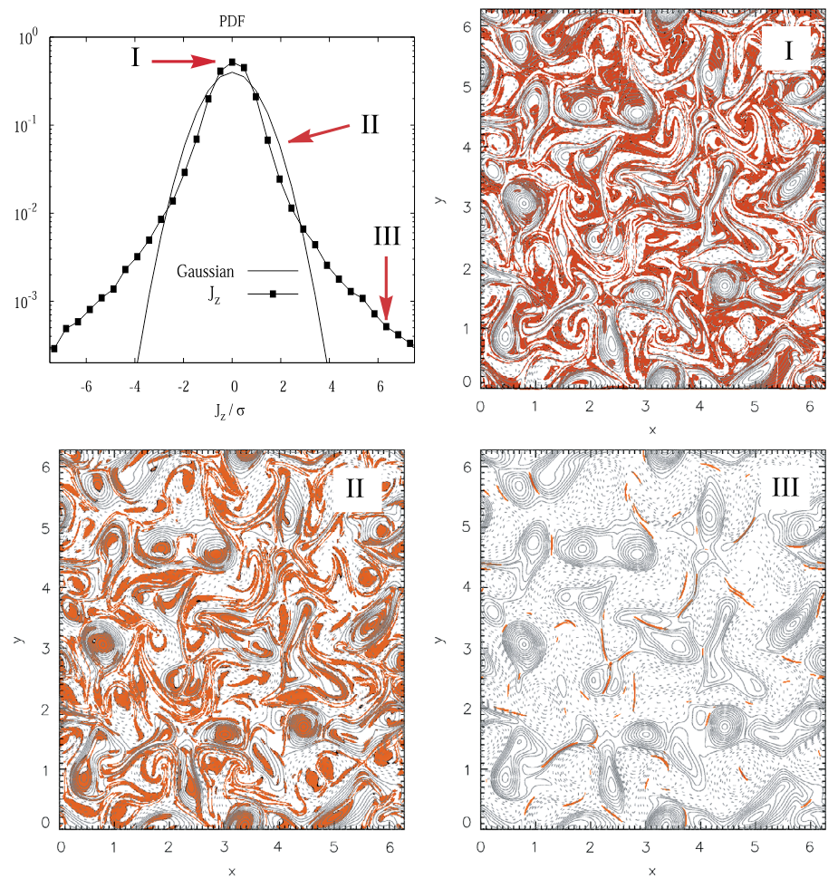
Turbulent Magnetic Fluctuations
PDF of the out-of-plane electric current density $J_{z}$ from a 2D MHD simulation, compared to a reference Gaussian (standard deviation $σ$). For each region I, II, and III, magnetic field lines (contours of constant magnetic potential $A_{z}$: > 0 solid, < 0 dashed) are shown; the colored (red) regions are places where the selected band (I, II, or III) contributes. (Greco et al. 2017)
Notes:
A physically appealing interpretation emerges: region I consists of very low values of fluctuations that lie mainly in the lanes between magnetic islands. Region II consists of sub-Gaussian current cores that populate the central regions of the magnetic islands (or flux tubes). Region III is composed of the coherent small-scale current sheet-like structures that form the sharp boundaries between the magnetic flux tubes. This classification provides a real-space picture of the nature of intermittent MHD turbulence.

Slide 10
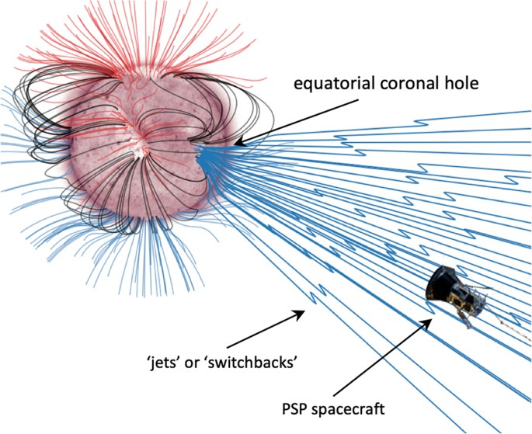
Current sheets, rotational discontinuities (RDs), tangential discontinuities (TDs), magnetic holes,
During encounter 1, PSP connected magnetically to a small negative-polarity equatorial coronal hole. (Bale et al. 2019)

Slide 11
Turbulence Transport Models (TTMs)
Broadband, low-amplitude, random-phase magnetic fluctuations
$$\begin{matrix} & δB^{s}=\sum_{n=1}^{N_{m}}{A_{n}}\left[cosα_{n}\left(cosϕ_{n}\hat{x}+sinϕ_{n}\hat{y}\right)+isinα_{n}\left(−sinϕ_{n}\hat{x}+cosϕ_{n}\hat{y}\right)\right]×exp\left(ik_{n}z+iβ_{n}\right) \\ & δB^{2D}=\sum_{n=1}^{N_{m}}{A_{n}}i\left(−sinϕ_{n}\hat{x}+cosϕ_{n}\hat{y}\right)×exp\left[ik_{n}\left(cosϕ_{n}x+sinϕ_{n}y\right)+iβ_{n}\right]\end{matrix} \left(2\right)$$
Wavelet-based synthetic turbulence model (Juneja et al. 1994) similar to p-model (Meneveau and Sreenivasan 1987).
Pucci et al. (2016) studied the influence of spectral extension and intermittency on particle transport.

Slide 12
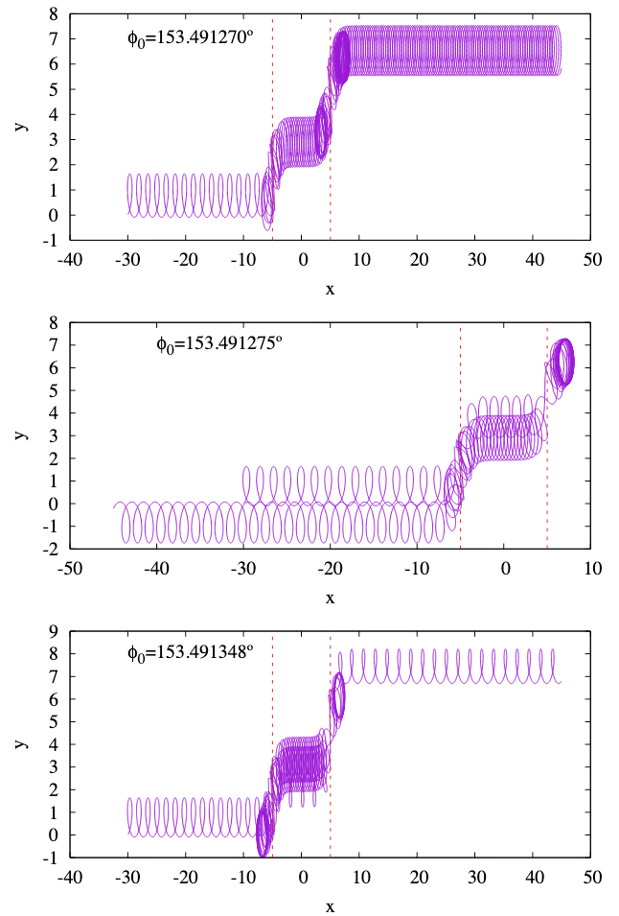
The Role of Current Sheets in Particle Transport
Trajectories of three particles of 1 MeV SEP interaction with switchback (two SDWs shown by red dashed lines) Malara et al. (2023)

Slide 13
Main Scientific Objective
Motivation / Gap : No prior studies systematically characterize particle interactions with solar wind current sheets
Quantitative understanding of how these structures influence energetic particles transport
This objective leads to two main tasks:
Observational characterization of solar wind current sheets across the heliosphere
Development of data-driven theoretical models for current sheet-induced particle scattering and transport

Slide 14
Part 1: Observational Analysis of Current Sheets

Slide 15
“ Wanderer, there is no path the path is forged as you wander. ” - Antonio Machado

Slide 16
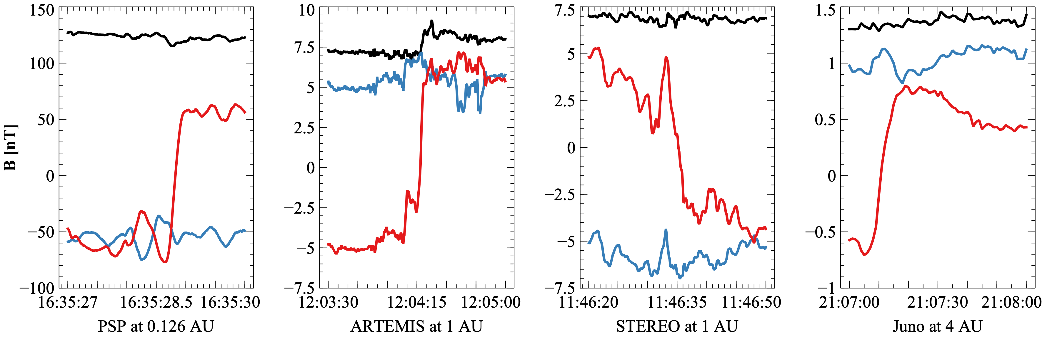
What are the properties of current sheets that are most relevant to particle transport?
Similar to the role of turbulence level, spectral index, anisotropy and intermittency in turbulence transport models
As a first-order model, we use a simple magnetic field configuration:
$$\begin{matrix}B & =B_{0}\left(cosθ e_{z}+sinθ\left(sinφ\left(z\right) e_{x}+cosφ\left(z\right) e_{y}\right)\right) \\ φ\left(z\right) & =βtanh\left(z/L\right)\end{matrix}$$
Current sheets detected by PSP, Juno, STEREO and near-Earth ARTEMIS satellite: red, blue, and black lines are $B_{l}$, $B_{m}$, and $\left|B\right|$.

Slide 17
Hamiltonian formalism
The motion of particle after simplification and normalization:
$$\begin{matrix}\tilde{H} & =\frac{1}{2}\left({\left(\tilde{p_{x}}−f_{1}\left(z\right)\right)}^{2}+{\left(\tilde{x}cotθ+f_{2}\left(z\right)\right)}^{2}+{\tilde{p_{z}}}^{2}\right) \\ f_{1}\left(z\right) & =\frac{1}{2}cosβ \left(\text{Ci}\left(βs_{+}\left(z\right)\right)−\text{Ci}\left(βs_{−}\left(z\right)\right)\right)+\frac{1}{2}sinβ \left(\text{Si}\left(βs_{+}\left(z\right)\right)−\text{Si}\left(βs_{−}\left(z\right)\right)\right), \\ f_{2}\left(z\right) & =\frac{1}{2}sinβ \left(\text{Ci}\left(βs_{+}\left(z\right)\right)+\text{Ci}\left(βs_{−}\left(z\right)\right)\right)−\frac{1}{2}cosβ \left(\text{Si}\left(βs_{+}\left(z\right)\right)+\text{Si}\left(βs_{−}\left(z\right)\right)\right)\end{matrix} \left(3\right)$$
Four key parameters:
Occurrence rate
Shear angle $β$ => $J_{m}=−\frac{1}{μ_{0}V_{n}}\frac{dB_{l}}{dt}$ Current density
Normal direction $θ$
Current sheet thickness (compared to the particle gyroradius)
Example of a current sheet observed by ARTEMIS. Top: magnetic field in the current sheet $\text{lmn}$ coordinate system where $l$ represents the maximum variance direcction ($B_{x}=B_{t}sinφ$ in our model), $m$ the intermediate variance direction ($B_{y}=B_{t}cosφ$), and $n$ the minimum variance direction ($B_{z}=B_{0}cosθ$). Here, $B_{t}$ and $B_{0}$ represent the tangential and total magnetic fields, respectively. Bottom: variations of the azimuthal angle $φ$ and the azimuthal angle $θ$ across the current sheet. Vertical lines indicate the current sheet boundaries, and the horizontal line represents $π/2$

Slide 18
What do we know about these parameters across the heliosphere?
Past studies Vasko et al. (2024) often lacked simultaneous multi-point measurements, employed different identification and quantification methods, and did not sufficiently separate temporal variability from spatial trends—contributing to significant uncertainties.
From inner heliosphere (Parker Solar Probe, PSP) to 1 AU (ARTEMIS, Wind) to outer heliosphere (Juno).

Slide 19
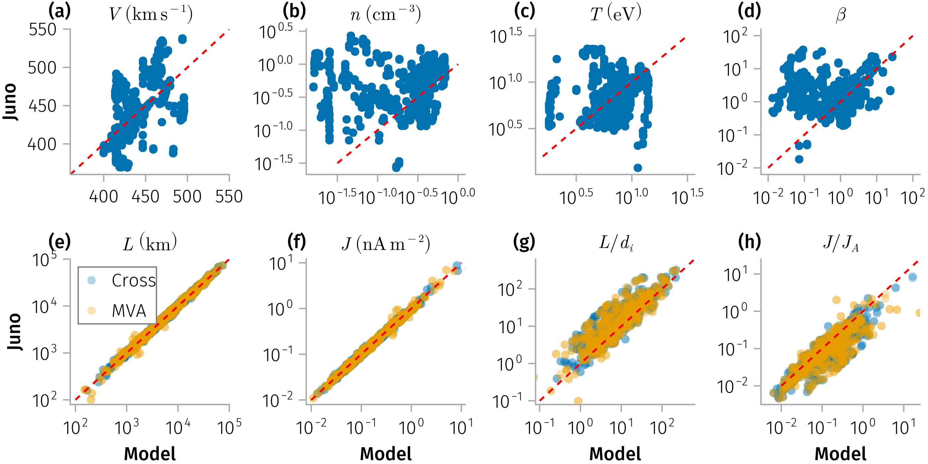
Dataset and Methods
Figure 1: Comparison of solar wind properties (top) and discontinuity properties (bottom) between / using model (x-axis) and JADE observations (y-axis). (a-d) Solar wind velocity, density, temperature, and plasma beta. (e-h) Discontinuity thickness, current density, normalized thickness, and normalized current density. Blue dots indicate values derived using the cross-product normal method, while yellow dots correspond to values obtained using minimum variance analysis.

Slide 20
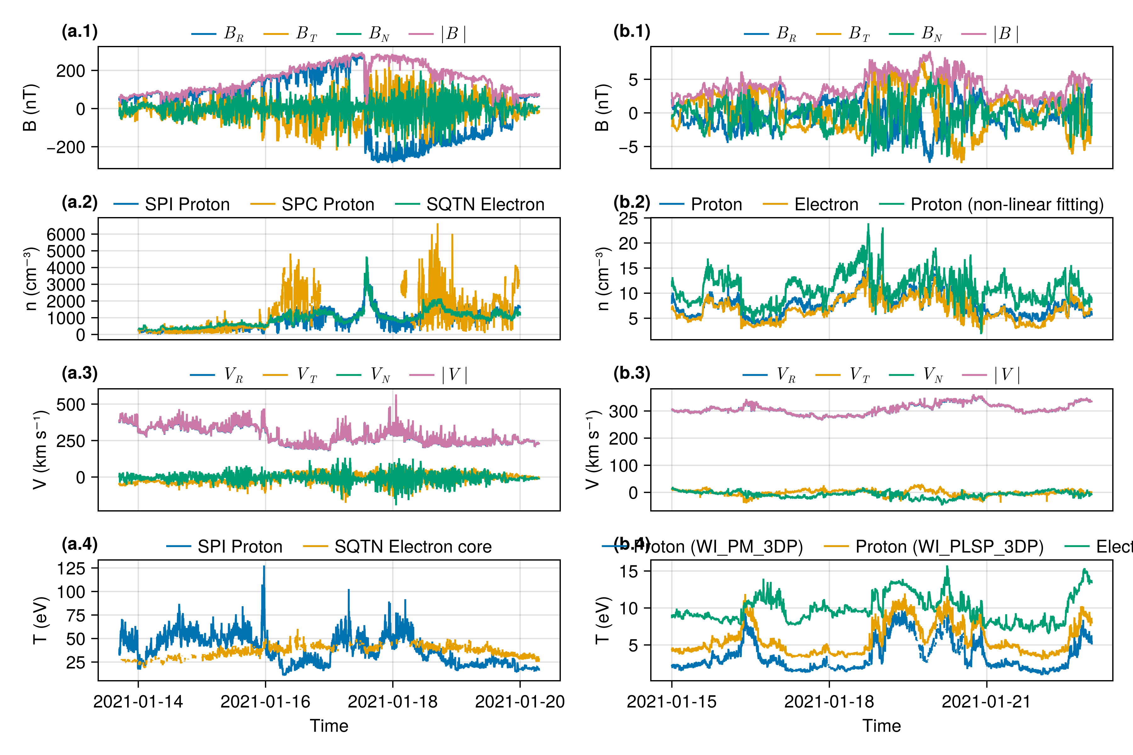
Overview of solar wind properties during encounter 8 (when PSP is aligned with Earth observations)

Slide 21
Discontinuity Properties
Occurrence rate
Waiting time probability density functions $p\left(τ\right)$ for Juno at 1 AU in 2011 (top) and 5 AU in 2016 (bottom). Observed data (black) are fitted with Weibull (blue) and exponential (orange) distributions. Vertical dashed lines denote the mean waiting times for each fitted distribution.

Slide 22
Figure 2: Left: the occurrence rate of discontinuities measured by Juno, STEREO-A, THEMIS-B, and Wind. Right: the normalized occurrence rate as a function of radial distance.

Slide 23
Current density and thickness
Figure 3: Distribution of various SWD properties observed by Juno, grouped by radial distance from the Sun (with colors shown at the top). Panel (a) thickness, (b) current density, (c) normalized thickness, (d) normalized current density.

Slide 24
Critical empirical constraints for particle transport modeling

Slide 25
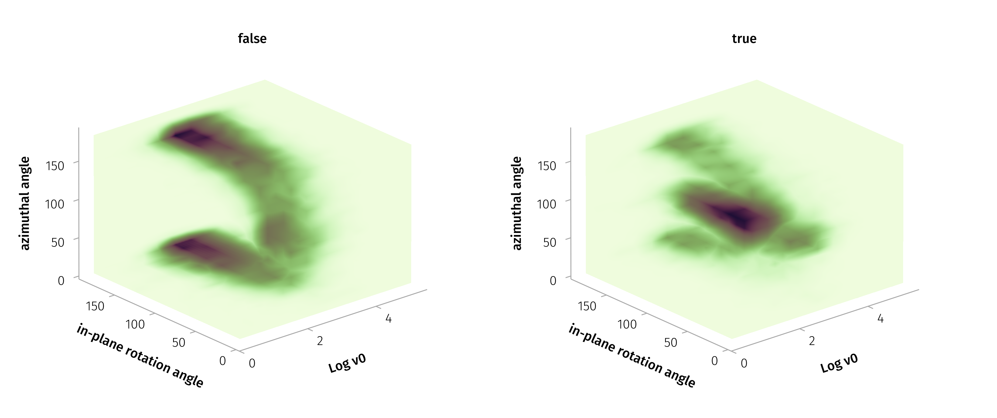
Results and Implications
solar wind current sheets maintain kinetic-scale thicknesses throughout the inner heliosphere
normalized thickness and current density remain nearly constant over the range from 0.1 to 5 AU
occurrence rates decreases approximately as $1/r$ with radial distance between 1 and 5 AU (geometric effect)
Figure 4: 3D density plots of the azimuthal angle $θ$, in-plane rotation angle $ω_{in}$, and logarithm of the characteristic velocity $log{\tilde{v}}_{B}$. The left panel corresponds to cases where the MVAB accuracy conditions are satisfied, while the right panel represents cases where they are not satisfied.

Slide 26
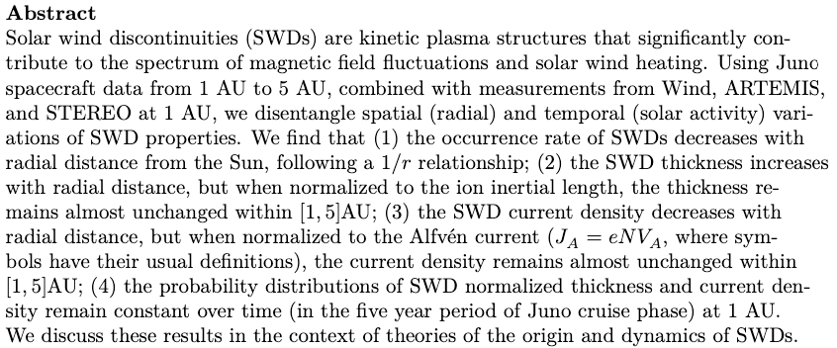
Summary
This work is presented in “Solar wind discontinuities in the outer heliosphere: Spatial distribution between 1 and 5 AU” (Zhang et al., submitted to JGR Space Physics, 2025, manuscript is available at 10.22541/essoar.174431869.93012071/v1).

Slide 27
Part 2: Quantitative Modeling of Particle Scattering

Slide 28
In physics, you don’t have to go around making trouble for yourself – nature does it for you. - Frank Wilczek
Question: What is the specific role of coherent structures—particularly current sheets—in shaping scattering processes (as a function of particle energy and current sheet geometry)?
Approach: Combined statistical measurements of current sheets at 1 AU with a Hamiltonian analytical framework and test particle simulations.
$$\tilde{H}=\frac{1}{2}\left({\left(\tilde{p_{x}}−f_{1}\left(z\right)\right)}^{2}+{\left(\tilde{x}cotθ+f_{2}\left(z\right)\right)}^{2}+{\tilde{p_{z}}}^{2}\right)$$

Slide 29
Adiabatic invariant and its violation at separatrix crossings
Phase portraits of the Hamiltonian in the plane of $\left(z,p_{z}\right)$ at fixed $\left(κx,p_{x}\right)$ for $β=1$. Each curve corresponds to a specific $H$, indicated on the plots. The left panel corresponds to $κx=4$, $p_{x}=1$, while the right panel corresponds to $κx=0$, $p_{x}=0.5$. (b) Phase plane of the Hamiltonian in the $\left(κx,p_{x}\right)$ space. The red line represents the uncertainty curve and the blue line delineates the boundary encompassing all possible phase points. (c) Potential energy profiles defined by $U\left(z\right)=H−p_{z}^{2}/2$ at different locations in the $\left(κx,p_{x}\right)$ place, corresponding to the labeled positions (#) in panel (b).

Slide 30
Part 1.5: Multifluid Model for Current Sheet Alfvénicity

Slide 31
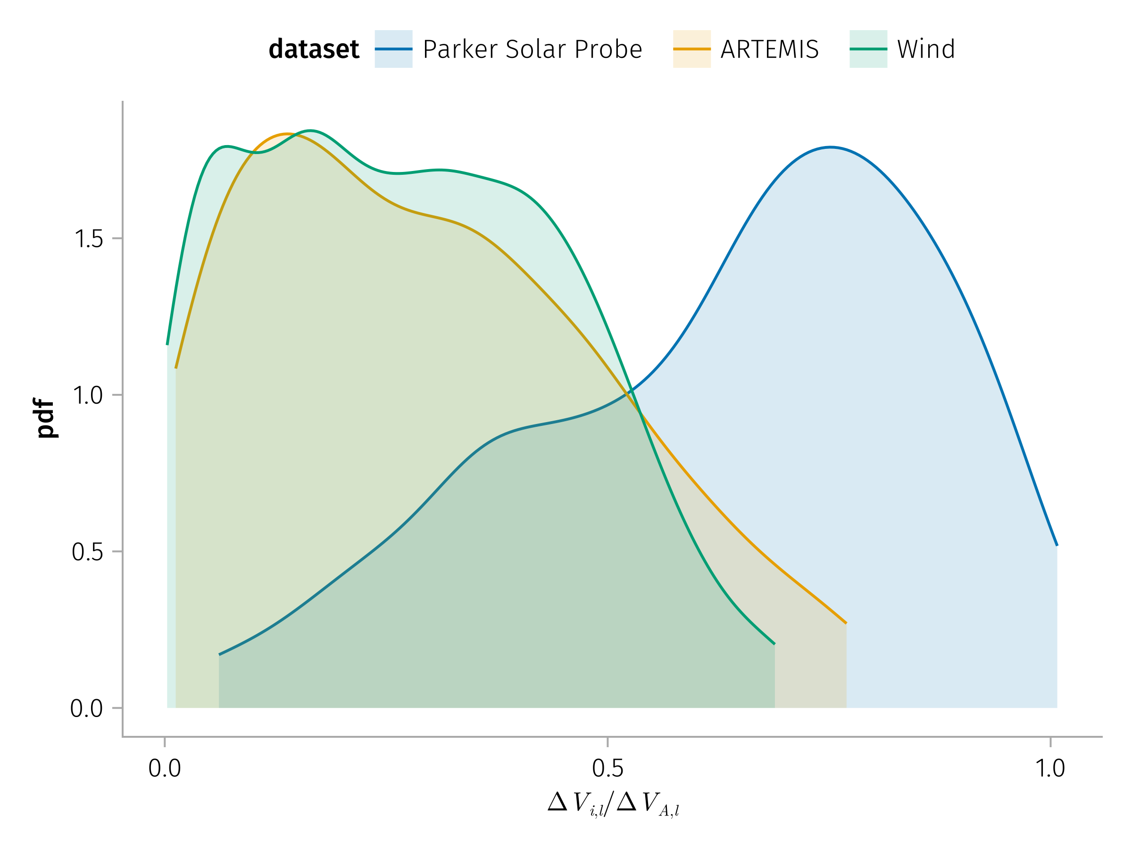
The goal of physics is to find the simplest possible description that accounts for all observations.
Question: Why do current sheets appear increasingly non-Alfvénic with distance, despite their force-free magnetic structure?
Statistics of the asymptotic velocity ratio from PSP, Wind, and ARTEMIS spacecraft observations during PSP encounter 7 period from 2021-01-14 to 2021-01-21.

Slide 32
α​ΓαmαΔvA,x=α​mαnα∞α​mαΓα2nα∞ΔUx 4
where $Γ_{α}=n_{α}u_{αz}$ is constant parameter from the conservation of fluid mass.
For a single-fluid plasma, this expression reduces to the simpler $Δv_{A,x}=ΔU_{x}$ f
For two counter-streaming ion fluids with $m_{1}=m_{2},u_{z,1}\left(∞\right)=−u_{z,2}\left(∞\right)$, the above expression can be further simplified to:
$$\left|n_{1}\left(∞\right)−n_{2}\left(∞\right)\right|Δv_{A,x}=\left(n_{1}\left(∞\right)+n_{2}\left(∞\right)\right)ΔU_{x}$$

Slide 33
Figure 5: Magnetic field, ion density, and ion bulk velocity for the case where $n_{1}=1.5n_{2}$ and $L=d_{i},B_{0}=2B_{z}$. Here, $z$ is the distance from the center of the 1-D current sheet, $n_{α}$ denotes the number density of ion species $α$, $d_{i}$ is the asymptotic ion inertial length, and $B_{0}$ is the in-plane magnetic field strength.

Slide 34
Figure 6: Ion bulk velocity in the $x$ direction (maximum variance direction) $U_{x}$ profiles normalized by local Alfvén velocity $v_{A,x}\left(z\right)=B_{x}\left(z\right)/\sqrt{μ_{0}m_{p}n\left(z\right)}$ for different $n_{1}\left(∞\right)$

Slide 35
Part 0: Software Development

Slide 36
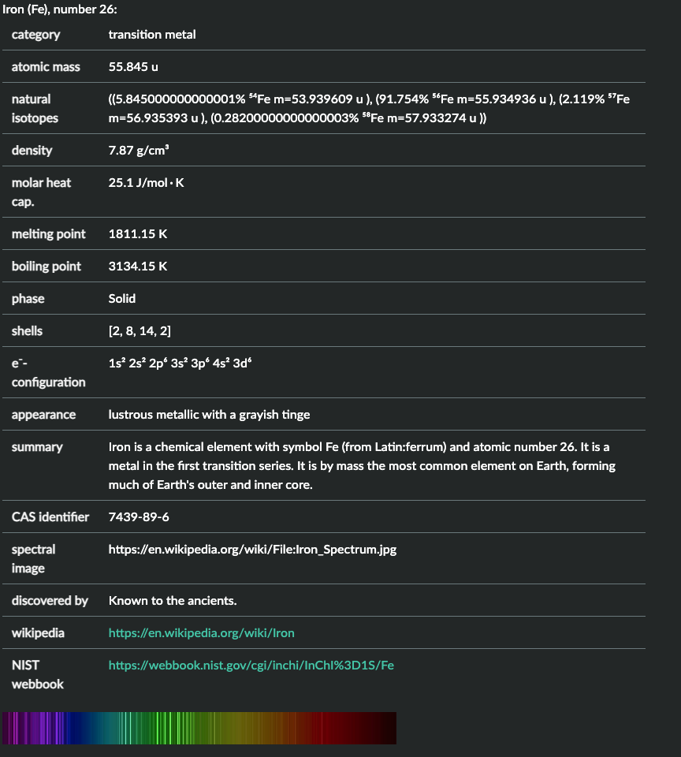
Programming is not about typing, it’s about thinking. - Rich Hickey
PlasmaFormulary.jl: Calculation done performantly, flexibly and right. <=> plasmapy.formulary
julia> gyrofrequency(0.01u"T", :e) ≈ gyrofrequency("electron", 1e7u"nT") 1.7588200107721632e9 rad s⁻¹
ChargedParticles.jl: representing charged particles with type (memory-efficient, ready to use in test particle / PIC simulations).
julia> p = particle("Fe") julia> p.element

Slide 37
SpaceDataModel.jl: Data model for handling space/heliospheric science data: plain configuration and hierarchical abstractions. <=> SPASE metadata model.
name = "Magnetospheric Multiscale" [metadata] abbreviation = "MMS" # Instruments [instruments.fpi] name = "Fast Plasma Investigation" datasets = ["fpi_moms"] [datasets.fpi_moms] format = "MMS{probe}_FPI_{data_rate}_L2_{data_type}-MOMS" ...
[datasets.fpi_moms.metadata] probes = [1, 2, 3, 4] data_rates = ["fast", "brst"] data_types = ["des", "dis"] [datasets.fpi_moms.parameters] numberdensity = "mms{probe}_{data_type}_numberdensity_{data_rate}" bulkv_gse = "mms{probe}_{data_type}_bulkv_gse_{data_rate}" temppara = "mms{probe}_{data_type}_temppara_{data_rate}" tempperp = "mms{probe}_{data_type}_tempperp_{data_rate}" energyspectr_omni = "mms{probe}_{data_type}_energyspectr_omni_{data_rate}"

Slide 38
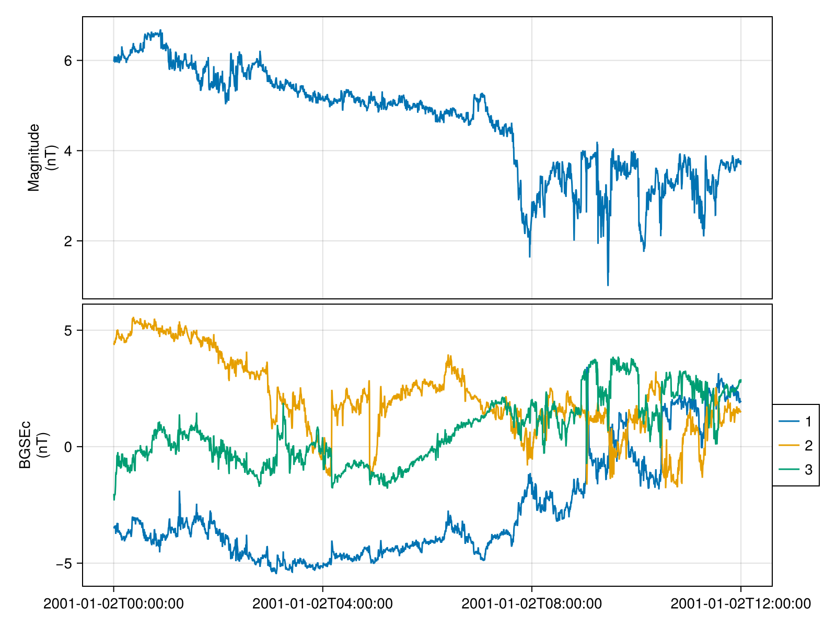
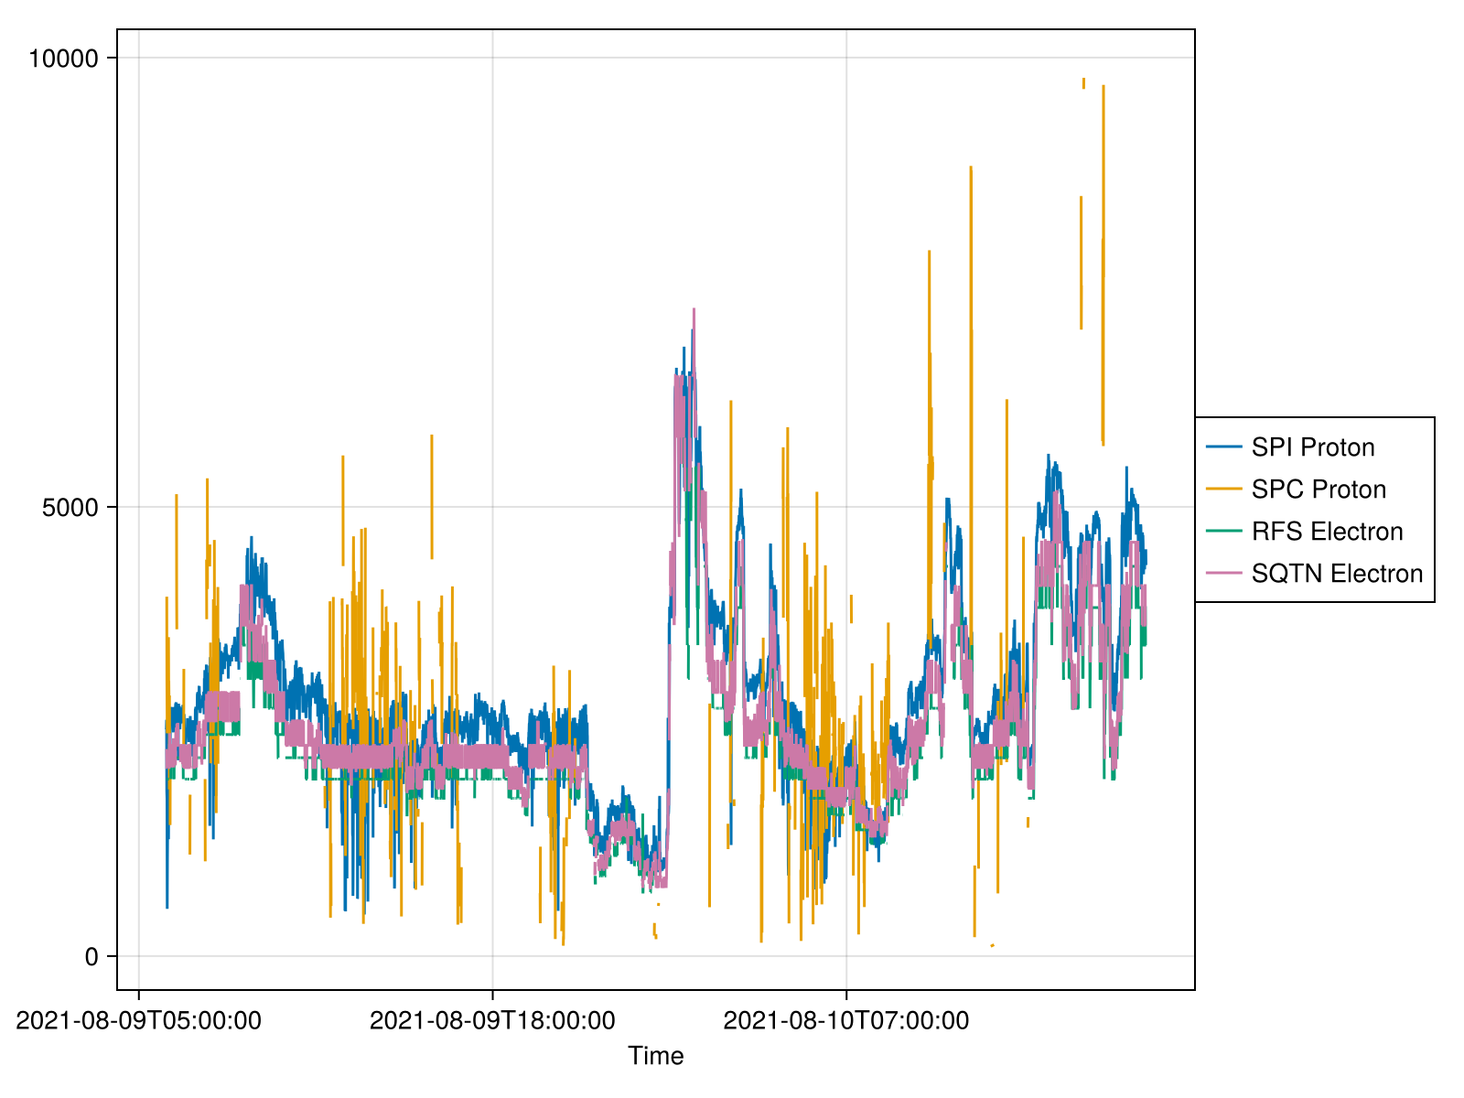
Speasy.jl: get data from main Space Physics WebServices. PySPEDAS.jl: A Julia wrapper around PySPEDAS. HAPIClient.jl: A Julia client for the Heliophysics Application Programmer’s Interface (HAPI).
using SPEDAS, HAPIClient, Speasy tplot("CDAWeb/AC_H0_MFI/Magnitude,BGSEc", "2001-1-2", "2001-1-2T12") n = DataSet("Density", [ SpeasyProduct("PSP_SWP_SPI_SF00_L3_MOM/DENS"; labels=["SPI Proton"]), Base.Fix2(*, u"cm^-3") ∘ SpeasyProduct("PSP_SWP_SPC_L3I/np_moment"; labels=["SPC Proton"]), SpeasyProduct("PSP_FLD_L3_RFS_LFR_QTN/N_elec"; labels=["RFS Electron"]), SpeasyProduct("PSP_FLD_L3_SQTN_RFS_V1V2/electron_density"; labels=["SQTN Electron"]) ] ) tplot(n, "2021-08-09T06", "2021-08-10T18")
Get data using Heliophysics Application Programmer’s Interface (HAPI)
Get data using Speasy.jl

Slide 39
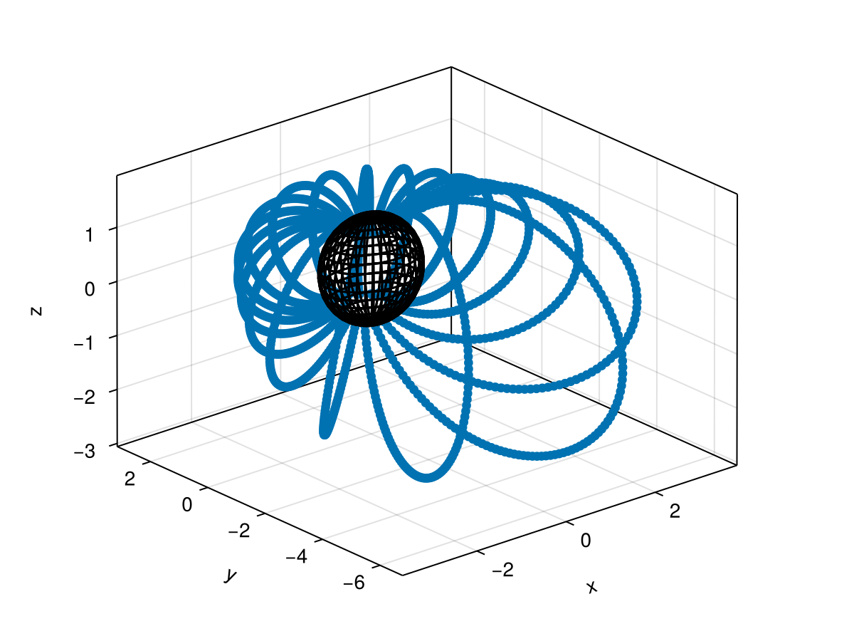
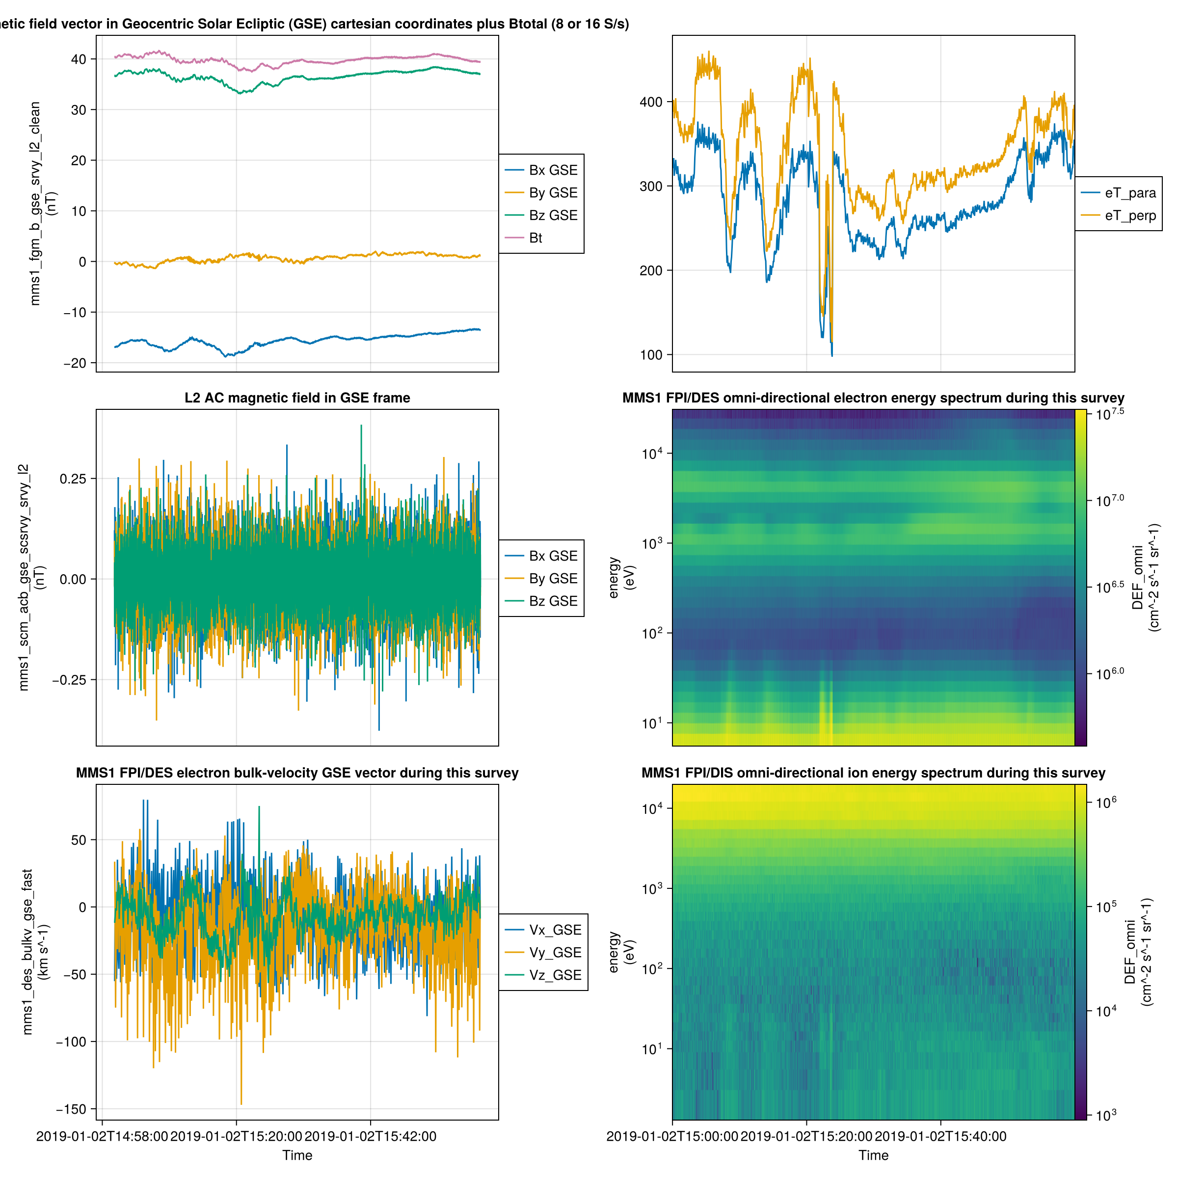
SPEDAS.jl : Julia-based Space Physics Environment Data Analysis Software framework.
Azimuthal field line visualization
SPEDAS.jl: Plotting multiple time series on a single figure

Slide 40
Part 3: Proposed Research

Slide 41
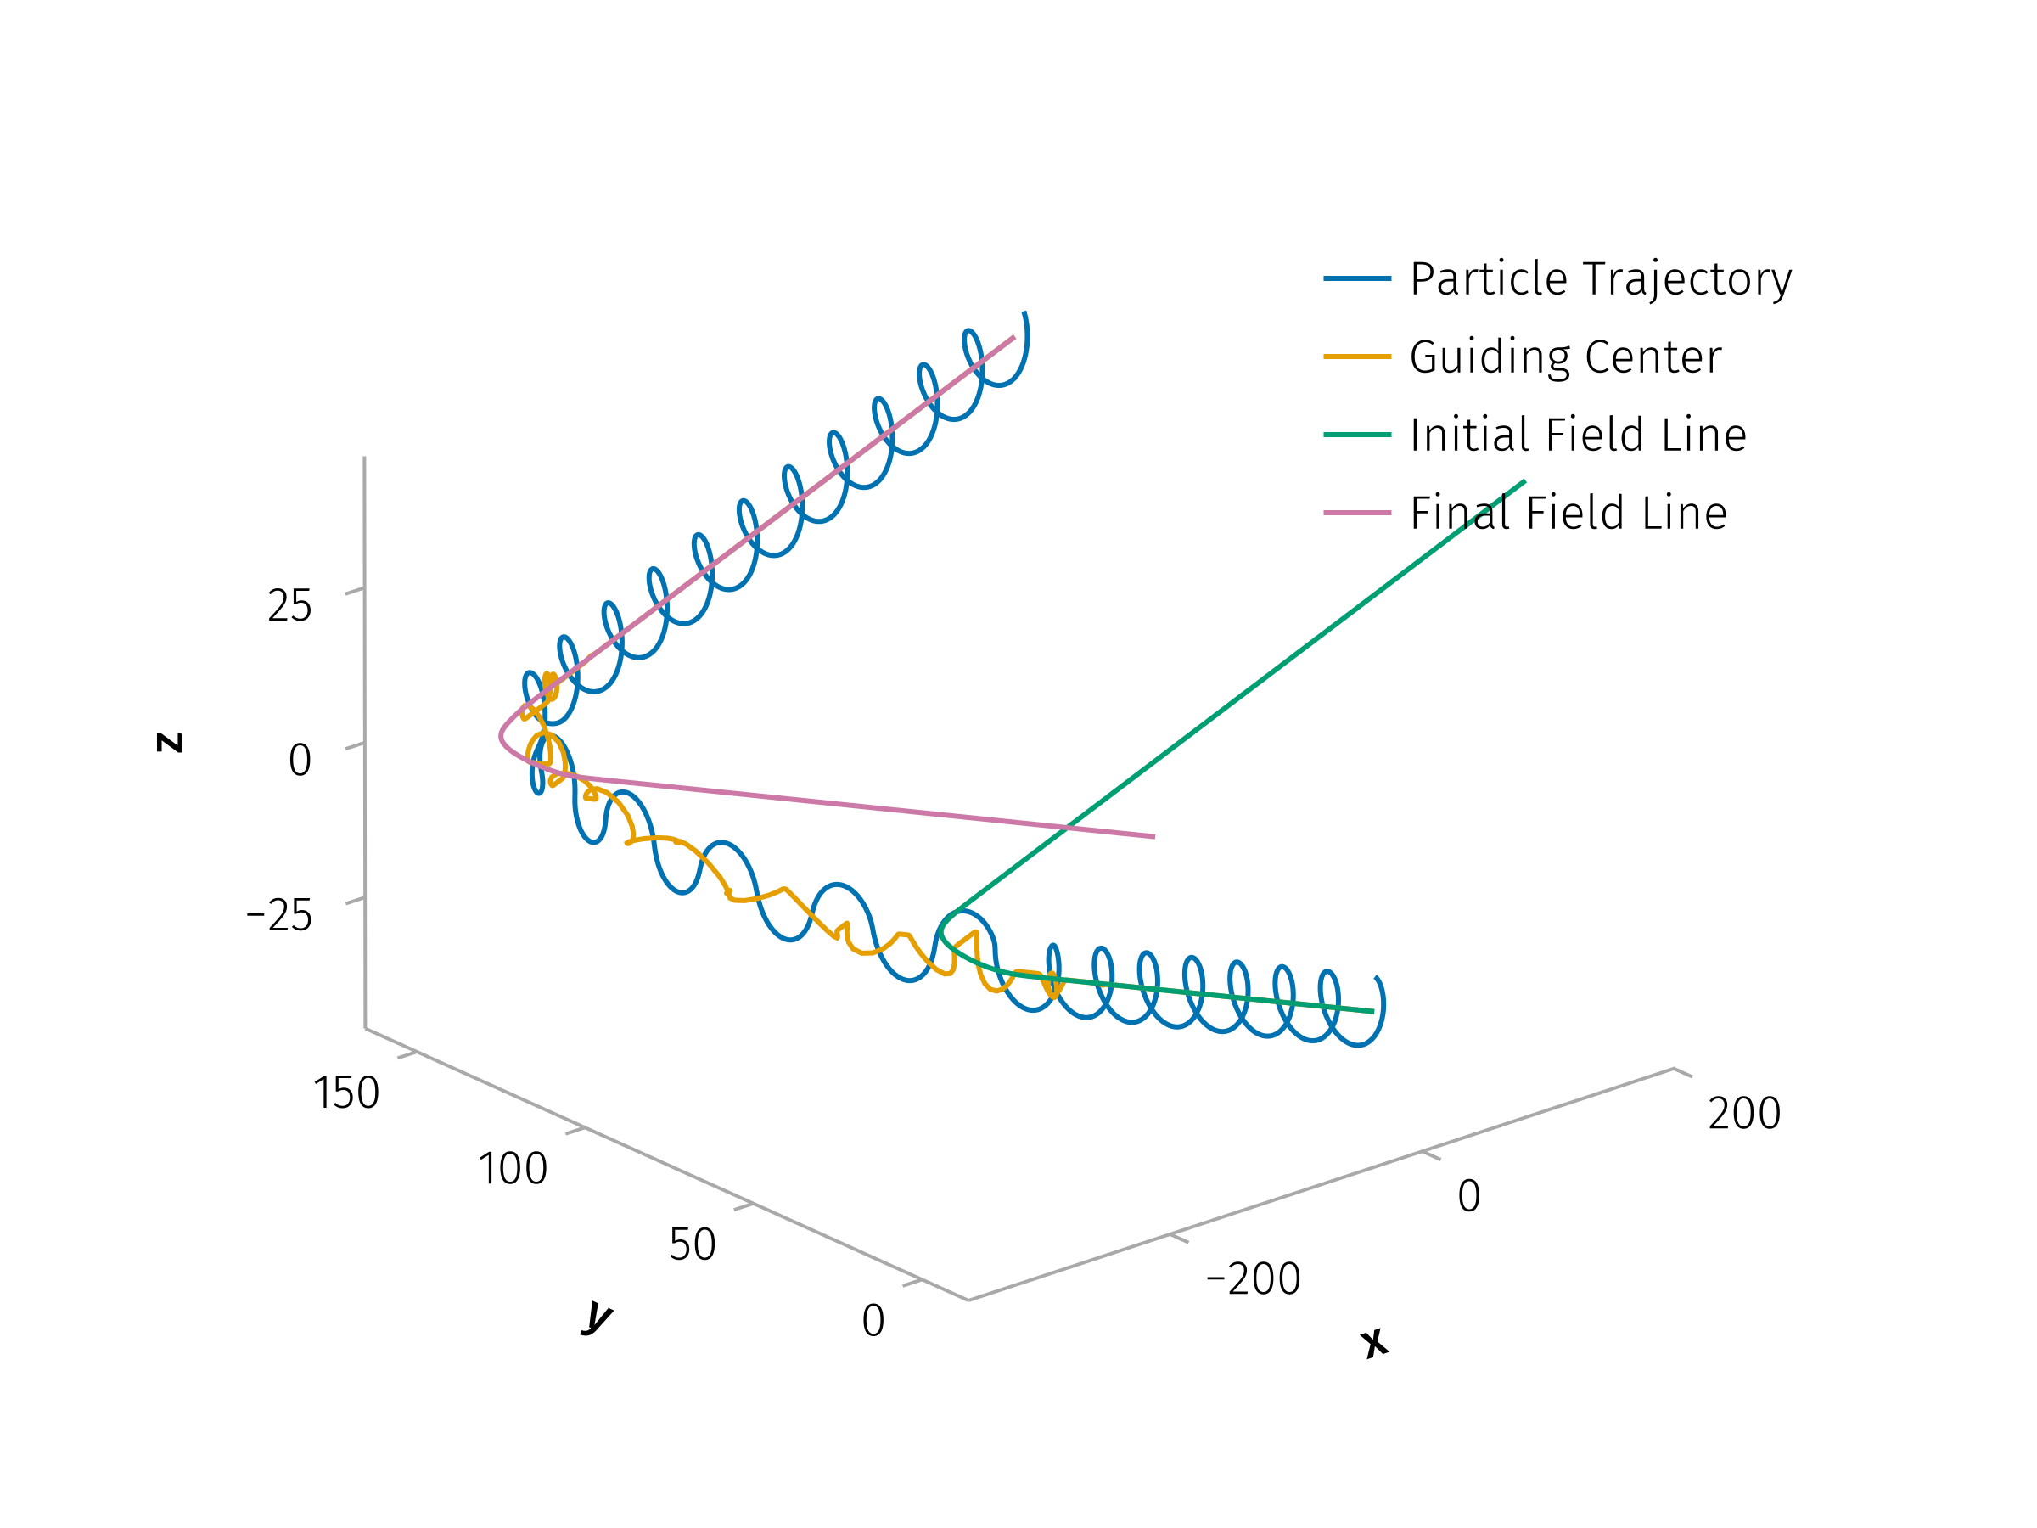
“ But still try, for who knows what is possible? ” - Michael Faraday
The total time between two consecutive current sheet encounters is modeled as the sum of the time spent inside the current sheet $T_{cs}$, and the time spent free-streaming between sheets $T_{fs}$, given by:
$$T=T_{cs}+T_{fs}, T_{fs}=\frac{s_{fs}}{\left|v_{∥,1}\right|}$$
where $v_{∥,0}$, $v_{∥,1}$ are the particle’s changed parallel velocity before and after interacting with the current sheet, respectively.
In the absence of scattering, the particle would follow the field line and travel a distance:
$$s_{0}=\left|v_{∥,0}\right|⋅T=\left|v_{∥,0}\right|\left(T_{cs}+\frac{s_{fs}}{\left|v_{∥,1}\right|}\right).$$
However, when scattering occurs, the total distance traveled becomes:
$$s=s_{cs}^{*}+\text{sign}\left(\frac{v_{∥,1}}{v_{∥,0}}\right)s_{fs}≈\text{sign}\left(\frac{v_{∥,1}}{v_{∥,0}}\right)s_{fs}$$
under the approximation that $s_{cs}^{*}<<s_{fs}$, where $s_{cs}^{*}$ is the effective parallel distance the particle travels within the current sheet. The net displacement compared to the unperturbed case is then:
$$Δs_{∥}=s−s_{0}=s_{fs}\left(\text{sign}\left(\frac{v_{∥,1}}{v_{∥,0}}\right)−\frac{\left|v_{∥,0}\right|}{\left|v_{∥,1}\right|}\right)−\left|v_{∥,0}\right|T_{cs}$$
The parallel spatial diffusion coefficient is then expressed as:
$$κ_{∥}=\frac{{\left(Δs_{∥}\right)}^{2}}{Δt}$$
Similarly, for the perpendicular direction:
$$κ_{⟂}=\frac{{\left(Δs_{⟂}\right)}^{2}}{T_{cs}+\left|s_{fs}/v_{∥,1}\right|}.$$
Figure 7: Example trajectory of a particle interacting with a current sheet

Slide 42
Conclusion

Slide 43
“ Still round the corner there may wait A new road or a secret gate ” - J. R. R. Tolkien

Slide 44
Timeline
Months 1–4:
Refine the pitch-angle scattering model to incorporate both parallel and perpendicular spatial diffusion effects.
Conduct detailed test-particle simulations using solar wind parameters derived from multi-spacecraft observations (PSP, Wind, Juno, etc.).
Months 5–7:
Identify observational signatures supporting the proposed scattering model.
Examine how current sheet properties influence SEP scattering across different heliocentric distances.
Months 8–10:
Finalize the spatial diffusion model and assess its implications for large-scale SEP propagation.
Synthesize simulation results and observational insights into dissertation chapters. Integrate observational and theoretical findings into comprehensive thesis documentation.

Slide 45
Opportunities for Future Research
Completion of this thesis opens several avenues for future investigations:
Exploration of current sheet interactions in other astrophysical environments, such as planetary magnetospheres.
Advanced integration of mapping techniques with numerical simulations to further refine SEP transport models.
Expanded observational campaigns utilizing upcoming spacecraft missions designed to probe heliospheric turbulence and particle dynamics at unprecedented resolution.

Slide 46
References

Slide 47
Bale, S. D., S. T. Badman, J. W. Bonnell, T. A. Bowen, D. Burgess, A. W. Case, C. A. Cattell, et al. 2019. “Highly Structured Slow Solar Wind Emerging from an Equatorial Coronal Hole.” Nature 576 (7786): 237–42. https://doi.org/10.1038/s41586-019-1818-7.
Greco, A., W. H. Matthaeus, S. Perri, K. T. Osman, S. Servidio, M. Wan, and P. Dmitruk. 2017. “Partial Variance of Increments Method in Solar Wind Observations and Plasma Simulations.” Space Science Reviews 214 (1): 1. https://doi.org/10.1007/s11214-017-0435-8.
Juneja, A., D. P. Lathrop, K. R. Sreenivasan, and G. Stolovitzky. 1994. “Synthetic Turbulence.” Physical Review E 49 (6): 5179–94. https://doi.org/10.1103/PhysRevE.49.5179.
Lario, D. 2010. “Heliospheric Energetic Particle Reservoirs: Ulysses and ACE 175-315 keV Electron Observations.” In Twelfth International Solar Wind Conference, 1216:625–28. AIP. https://doi.org/10.1063/1.3395944.
Liu, Y. Y., H. S. Fu, J. B. Cao, C. M. Liu, Z. Wang, Z. Z. Guo, Y. Xu, S. D. Bale, and J. C. Kasper. 2021. “Characteristics of Interplanetary Discontinuities in the Inner Heliosphere Revealed by Parker Solar Probe.” Astrophysical Journal 916 (2): 65. https://doi.org/10.3847/1538-4357/ac06a1.
Lotekar, A. B., I. Y. Vasko, T. Phan, S. D. Bale, T. A. Bowen, J. Halekas, A. V. Artemyev, Yu V. Khotyaintsev, and F. S. Mozer. 2022. “Kinetic-Scale Current Sheets in Near-Sun Solar Wind: Properties, Scale-dependent Features and Reconnection Onset.” The Astrophysical Journal 929 (1): 58. https://doi.org/10.3847/1538-4357/ac5bd9.
Malara, Francesco, S. Perri, J. Giacalone, and G. Zimbardo. 2023. “Energetic Particle Dynamics in a Simplified Model of a Solar Wind Magnetic Switchback.” Astronomy & Astrophysics 677 (September): A69. https://doi.org/10.1051/0004-6361/202346990.
Meneveau, C., and K. R. Sreenivasan. 1987. “Simple Multifractal Cascade Model for Fully Developed Turbulence.” Physical Review Letters 59 (13): 1424–27. https://doi.org/10.1103/PhysRevLett.59.1424.
Parker, E. N. 1965. “The Passage of Energetic Charged Particles Through Interplanetary Space.” Planetary and Space Science 13 (1): 9–49. https://doi.org/10.1016/0032-0633(65)90131-5.
Perri, S., and G. Zimbardo. 2007. “Evidence of Superdiffusive Transport of Electrons Accelerated at Interplanetary Shocks.” Astrophysical Journal 671 (December): L177–80. https://doi.org/10.1086/525523.
Pucci, F., F. Malara, S. Perri, G. Zimbardo, L. Sorriso-Valvo, and F. Valentini. 2016. “Energetic Particle Transport in the Presence of Magnetic Turbulence: Influence of Spectral Extension and Intermittency.” Monthly Notices of the Royal Astronomical Society 459 (3): 3395–3406. https://doi.org/10.1093/mnras/stw877.
Reames, Donald V. 2013. “The Two Sources of Solar Energetic Particles.” Space Science Reviews 175 (1): 53–92. https://doi.org/10.1007/s11214-013-9958-9.
Söding, A., F. M. Neubauer, B. T. Tsurutani, N. F. Ness, and R. P. Lepping. 2001. “Radial and Latitudinal Dependencies of Discontinuities in the Solar Wind Between 0.3 and 19 AU and -80$​^{∘}$ and +10$​^{∘}$.” Annales Geophysicae 19 (7): 667–80. https://doi.org/10.5194/angeo-19-667-2001.
Tan, Lun C. 2023. “Turbulent Origins of Particle Intensity Dropout in Gradual Solar Energetic Particle Events During Solar Cycle 23.” Astrophysical Journal 954 (1): 26. https://doi.org/10.3847/1538-4357/ace1f2.
Vasko, I. Y., K. Alimov, T. D. Phan, F. S. Mozer, and A. V. Artemyev. 2024. “Kinetic-Scale Current Sheets in the Solar Wind at 5 AU.” Journal of Geophysical Research: Space Physics 129 (6): e2024JA032586. https://doi.org/10.1029/2024JA032586.
Vasko, I. Y., K. Alimov, T. Phan, S. D. Bale, F. S. Mozer, and A. V. Artemyev. 2022. “Kinetic-Scale Current Sheets in the Solar Wind at 1 Au: Scale-Dependent Properties and Critical Current Density.” Astrophysical Journal Letters 926 (2): L19. https://doi.org/10.3847/2041-8213/ac4fc4.

